Slide 1
1) Introduction to stars and RADIATION

Slide 2
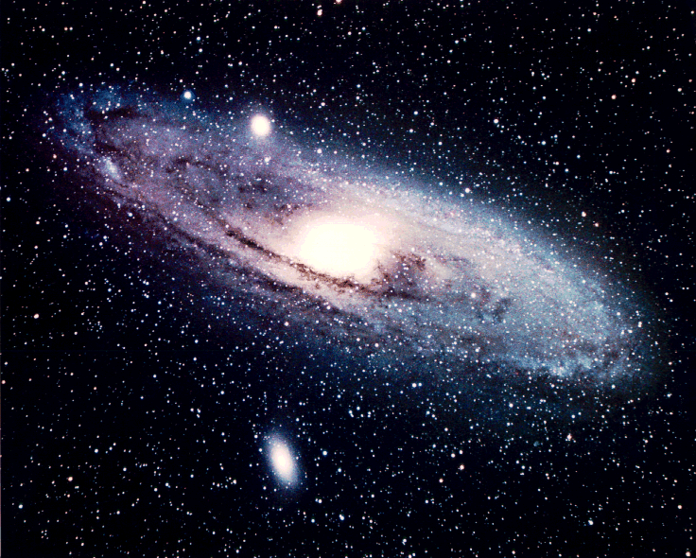
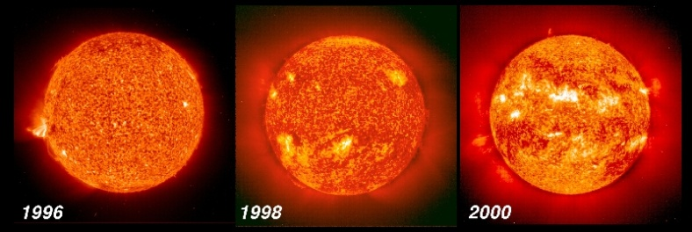
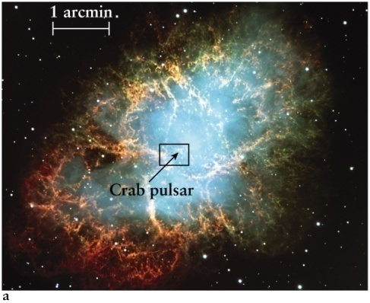
Stellar astrophysics - Nobel Heritage!
}
Analysing Starlight
}
Wien (1911)
Planck (1918)
Bohr (1922)
Dirac (1933)
Radiation
Energy
Atoms
}
Bethe (1967)
Fowler (1983)
Davis (2002)
}
Nuclear reactions
Chemical elements
Stellar interiors
}
Ryle (1974)
Hewish (1974)
Chandrasekhar (1982)
Hulse & Taylor (1993)
}
* End-states of stars
* Exotic objects!

Slide 3
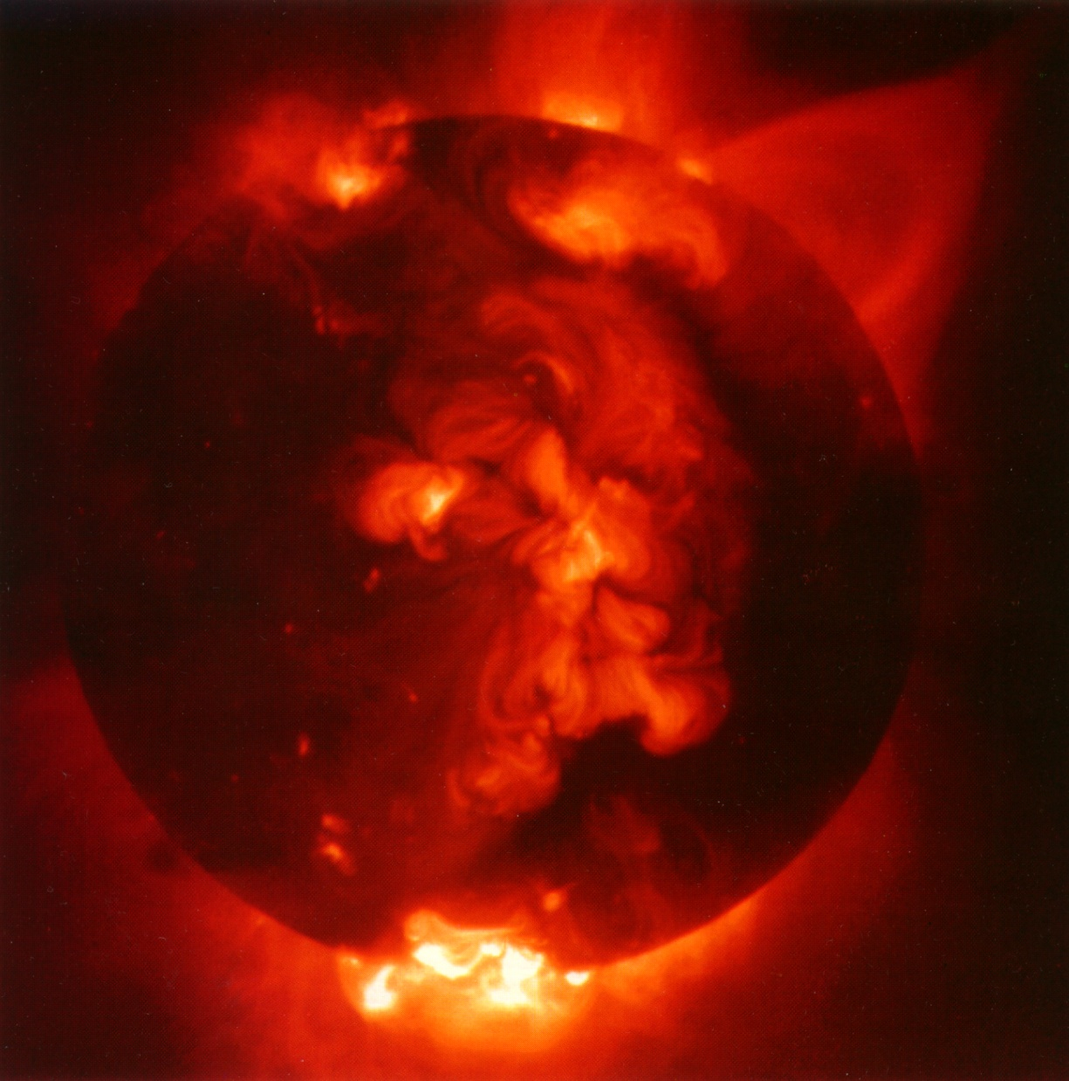
A star
Bound by self-gravity
Radiates energy from an internal source
The Sun is a very ordinary star!

Slide 4
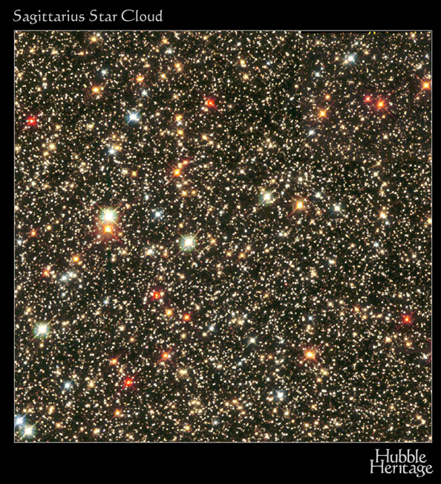
…tremendous variety of stars
E.g. Massive stars ➔
20 – 100 times more massive than the Sun
20 – 100 larger than the Sun
up to a million times more luminous

Slide 5
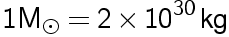
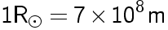
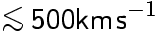
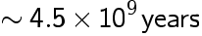
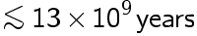
Stellar properties
Sun
stars
Mass
Radius
Temperature
Chemical composition
Magnetic field
Rotational velocity
Age

Slide 6
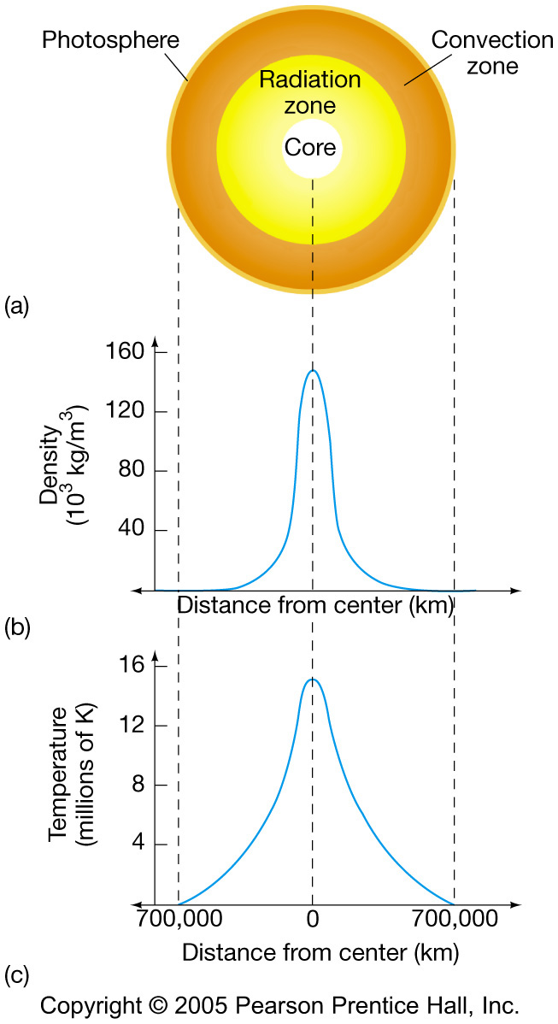
Main body of the Sun is defined by the dominant transport process
0 < core < R_{o}/4
R_{o}/4 < radiative < 0.8 R_{o}
0.8 R_{o} < convective < R_{o}
Solar atmosphere = photosphere + chromosphere + corona

Slide 7
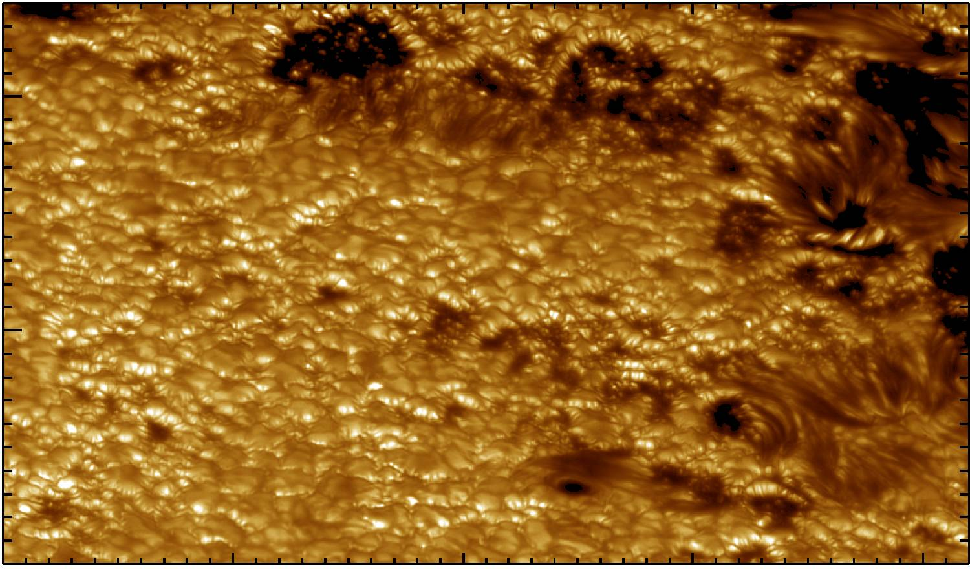
Solar surface from Swedish Solar Telescope
Resolution ~100km
Granule size ~1000km
Convective cells - granulation

Slide 8
Chromosphere – ~2000 km thick;
upper atmosphere; Temp ~ 4500K
Corona –
vast filamentary loops of hot plasma (2 x 10⁶K) (emits in X-rays, UV, EUV).

Slide 9
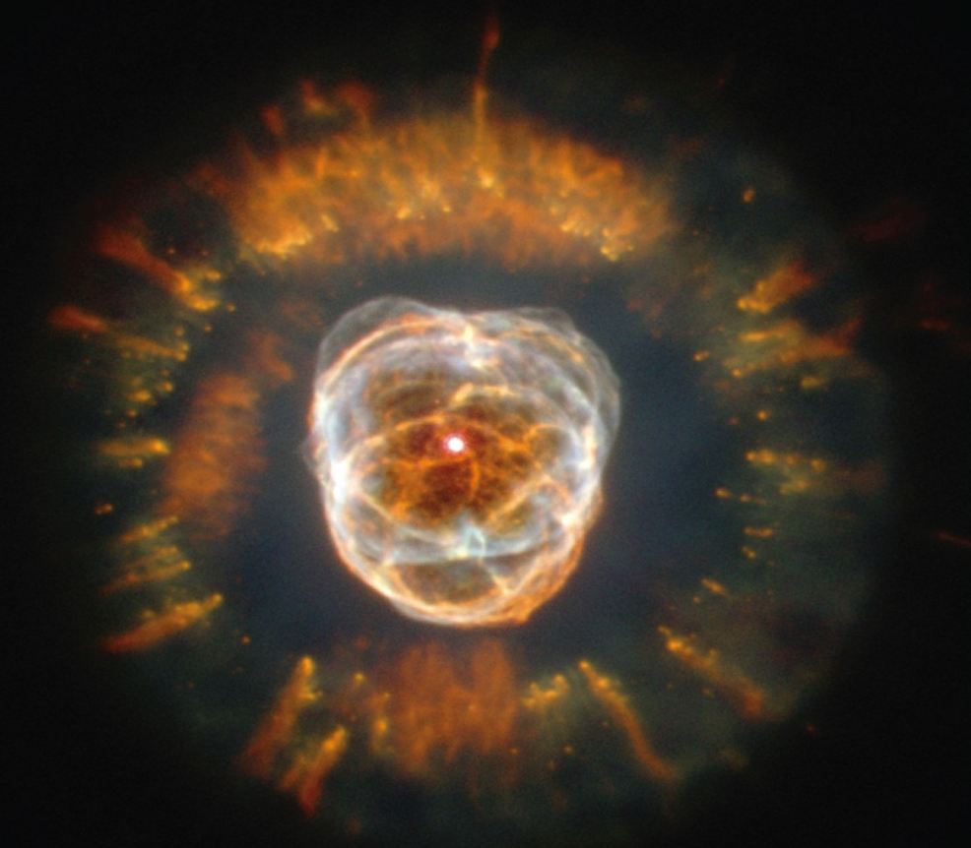
How do we figure out the properties of stars
0
By analyzing light received from a star, astronomers learn about the star’s…
Chemical composition
Surface temperature
Radius
Total energy output
Density
Velocity relative to Earth
Rotation period
Magnetic Fields
Light: The Cosmic Messenger !!

Slide 10
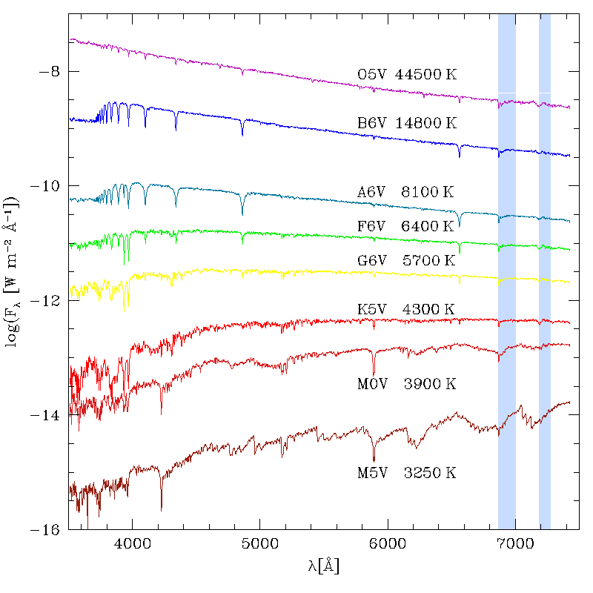
Stellar spectroscopy

Slide 11
Photons
Light can be thought of as packets (or ‘quanta’) of energy called photons. Photon energy, E:
ν = frequency (Hz) h = Planck’s constant (= 6.63 x 10⁻³⁴ J s)
high frequency
short wavelength
high energy
Examples of particle nature of light can be seen in:
Photo-electric effect
Atomic spectra
(e.g. previous notes...)
Notes:
Kirchoff coined the term ‘blackbody’ in 1862.
1900: Max Planck calculated the blackbody curve (major challenge) which fitted
the experimental data available (had to assume that energy of oscillators in
cavity was quantised)
1905: Einstein explains the photoelectric effect with quantised e.m. radiation
(it was known at the time that photoelectron energy increases with
increasing frequency of radiation)
→ E = hν

Slide 12
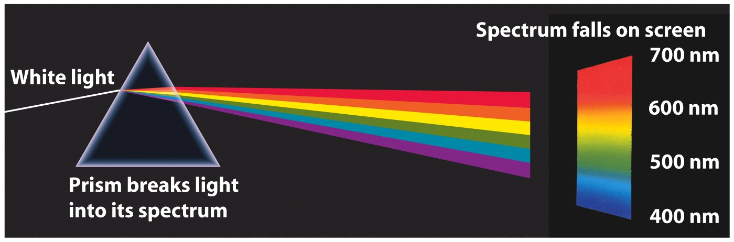
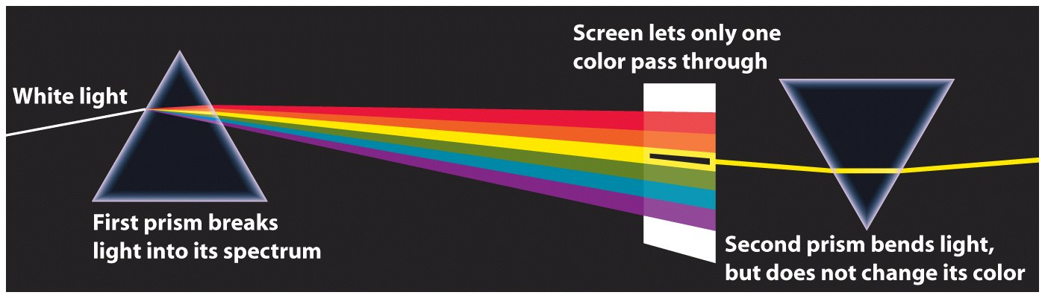
Light: spectrum and color
Newton found that the white light from the Sun is composed of light of different color, or spectrum (1670).

Slide 13
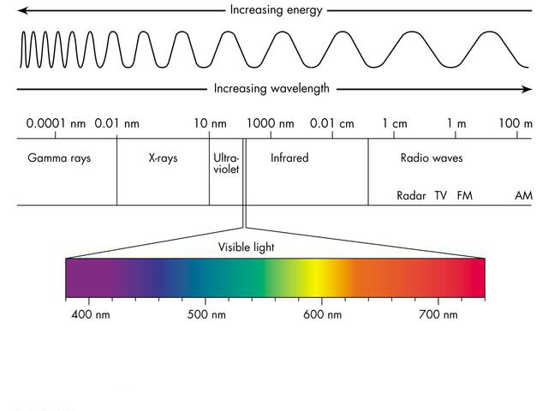
Electromagnetic spectrum

Slide 14
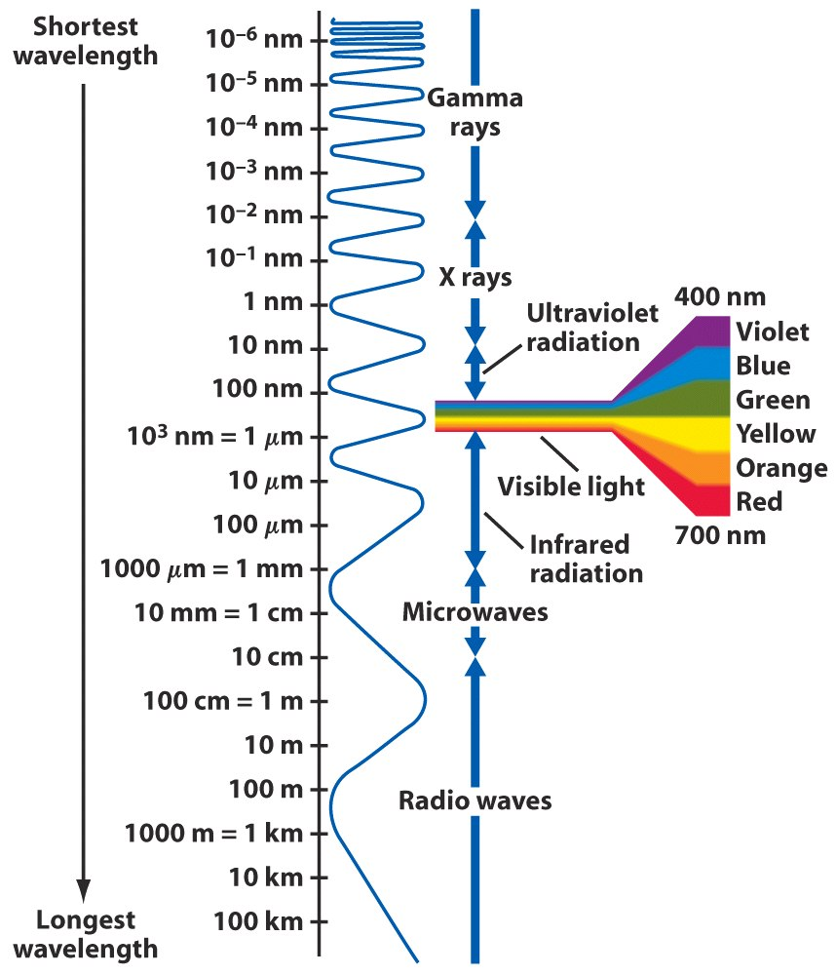
Electromagnetic Spectrum
Visible light falls in the 400 to 700 nm range
In the order of decreasing wavelength
Radio waves: 1 m
Microwave: 1 mm
Infrared radiation: 1 μm
Visible light: 500 nm
Ultraviolet radiation: 100 nm
X-rays: 1 nm
Gamma rays: 10⁻³ nm

Slide 15
Units
Wavelength: SI units – metre, m
Optical/UV: Angstrom, A 1A = 10⁻¹⁰ m = 10⁻⁸ cm = 0.1nm
nanometre, nm 1nm = 10⁻⁹ m
Infrared: micron, μm 1μm = 10⁻⁶ m
Frequency: SI units – Hertz, Hz
Radio: Gigahertz, GHz 1GHz = 10⁹ Hz
Energy: SI units – Joules, J
X-ray: electron volts, eV 1eV = 1.6x10⁻¹⁹ J
1keV = 1.6x10⁻¹⁶ J

Slide 16
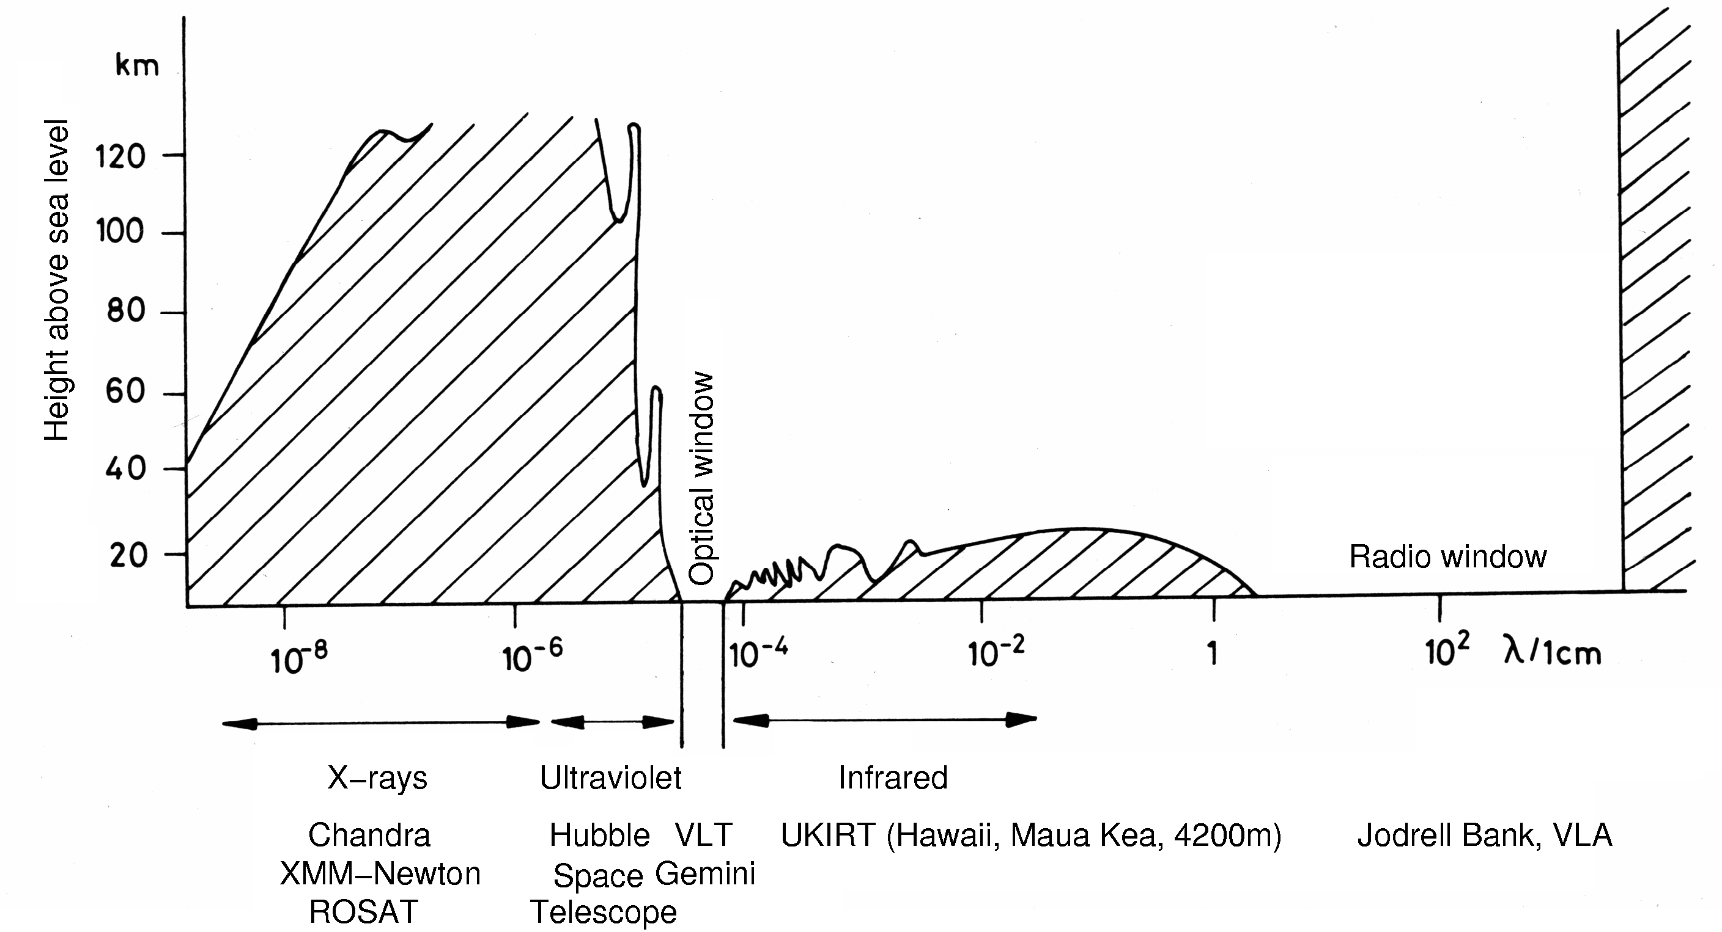
Penetration depths through the Earth atmosphere

Slide 17
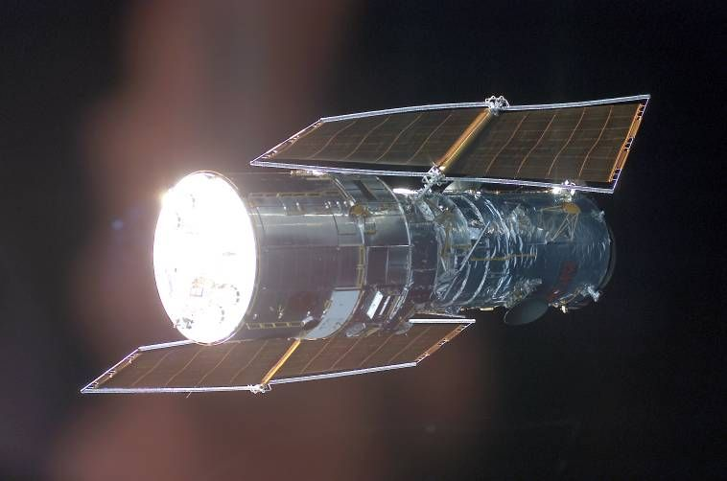
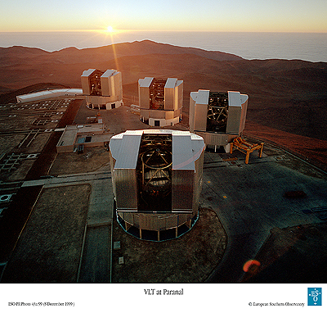
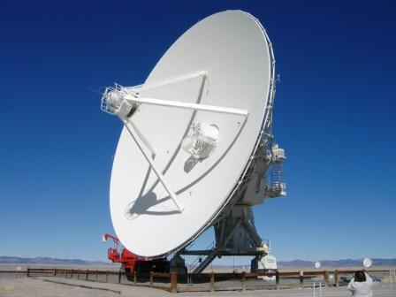
Penetration depths through the Earth atmosphere

Slide 18
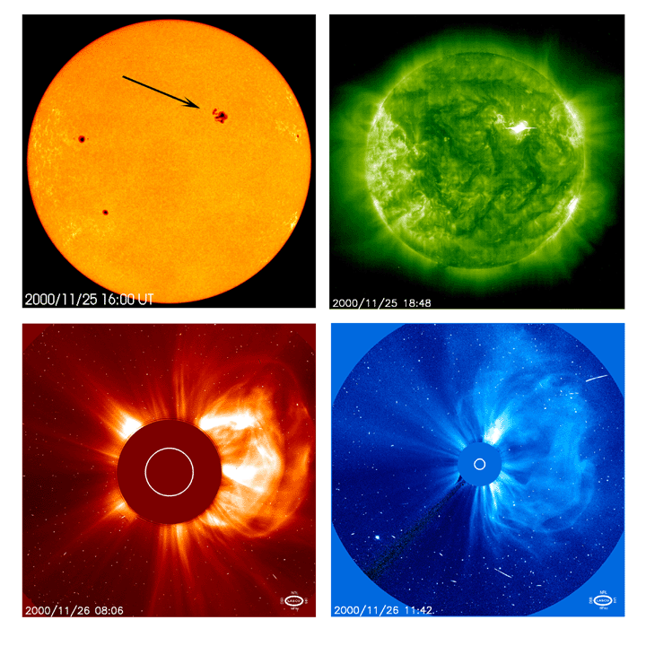
The Sun at Different Wavelengths
Visible
Ultraviolet
X-ray
X-ray

Slide 19
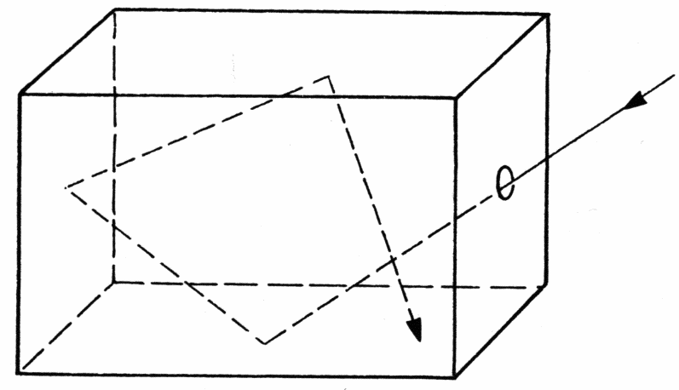
RECALL - ‘Thermal’ spectrum of radiation: Blackbody
Blackbody: A body which absorbs all radiation incident upon it.
To be in perfect thermal equilibrium, it must also emit
radiation at the same rate it absorbs it
➔ its temperature is maintained
Example: Perfectly insulated enclosure within which radiation
is in equilibrium with the enclosure walls
➔ observe blackbody radiation through a pinhole
Gases in the interior of stars are opaque to all radiation
➔ Surfaces of stars emit very closely to a
blackbody spectrum
a perfect absorber/emitter, absorbs all
intercepted photons

Slide 20
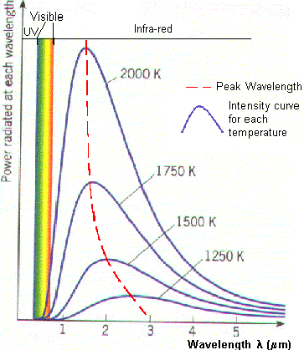
‘Thermal’ spectrum of radiation: Blackbody
In 1900 Planck postulated
e.m. energy propagates
in quanta, and derived the
blackbody radiation law:
where I(λ) is the intensity
emitted by a blackbody at
temperature T in the range
of wavelength λ and λ+Δλ
h: Planck’s constant
c: speed of light
k: Boltzmann’s constant
T: temperature in Kelvin
W m⁻² λ⁻¹ sr ⁻¹
Notes:
Note linear wavelength scale, because covers a limited wavelength range! Intensity is per interval of wavelength. Main characteristic is that the curves are very peaked, and peak moves to longer wavelengths as temperature decreases.

Slide 21
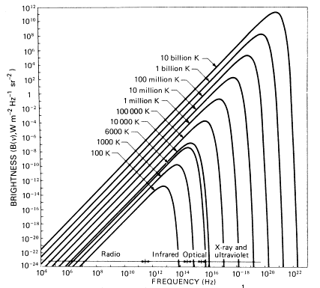
‘Thermal’ spectrum of radiation: Blackbody
Alternatively, we can express the blackbody radiation law
(also called Planck’s function) in terms of frequency:
where I(ν) is the intensity
emitted by a blackbody at
temperature T in the range
of frequency ν and ν +Δν
h: Planck’s constant
c: speed of light
k: Boltzmann’s constant
T: temperature in Kelvin
Notes:
Note log-log plot and units of vertical axis (this covers whole e-m spectrum!). Again curves are very peaked, with peak moving to higher frequency as temperature increases.

Slide 22
‘Thermal’ spectrum of radiation: Blackbody
Wien displacement law expresses wavelength at which maximum intensity of blackbody radiation is emitted as a function of temperature; it is obtained by setting
W m⁻² λ⁻¹ sr ⁻¹
➔
where λ_{max} in m
T in Kelvin
Notes:
Note log-log plot. Again curves are very peaked, with peak moving to higher frequency as temperature increases.

Slide 23
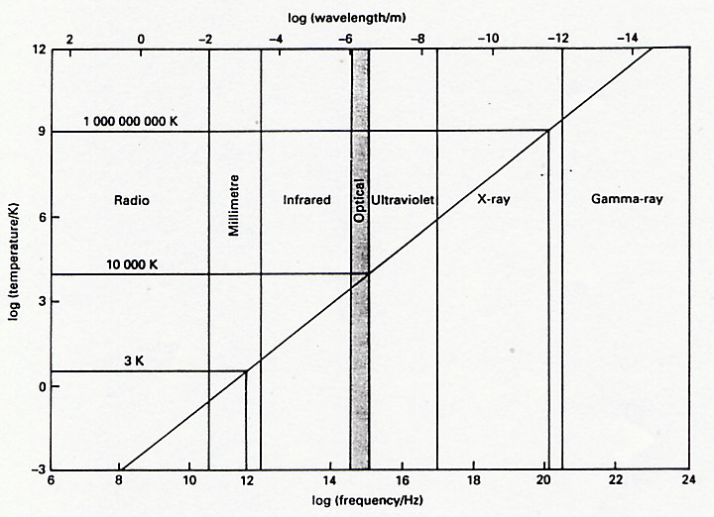
‘Thermal’ spectrum of radiation: Blackbody
Wien displacement law:
or
(ν in Hz)
(remember λν = c = 3 x 10⁸ m s⁻¹)

Slide 24

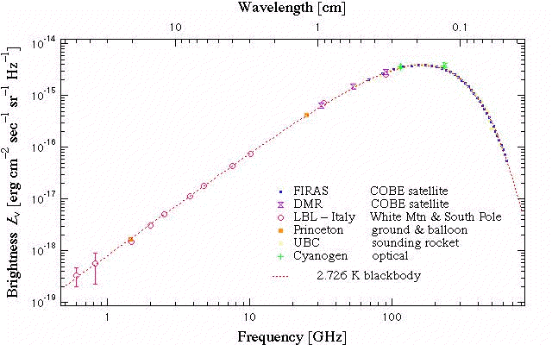
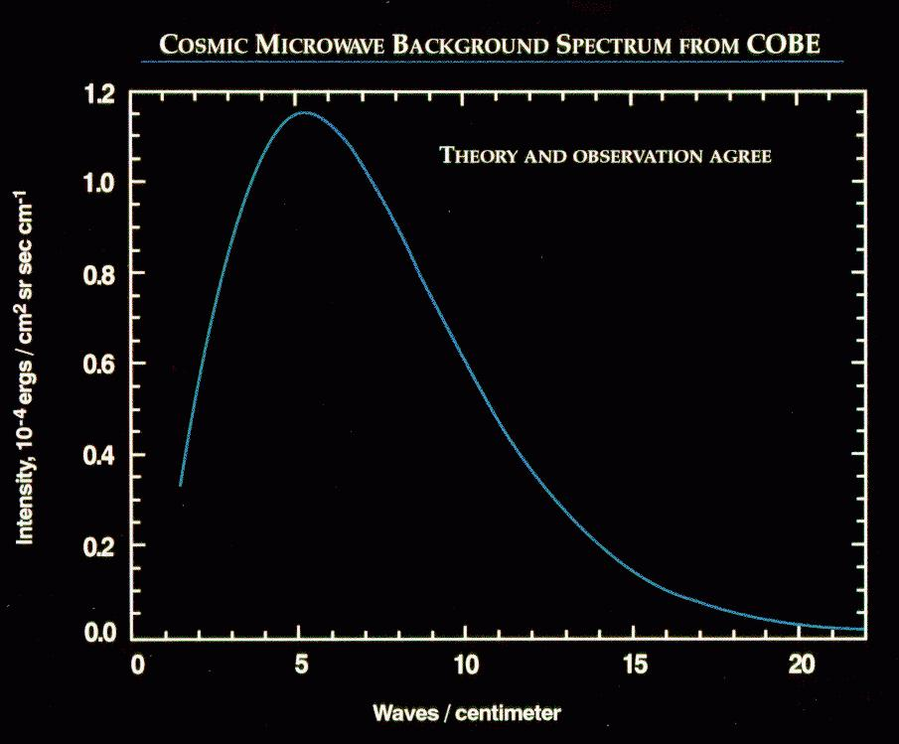
‘Thermal’ spectrum of radiation: e.g.
The best example of a blackbody is provided by the spectrum of the microwave background, the relic of the
Big Bang, known to be now at 2.7 K.
Notes:
COBE was launched November 18, 1989 and carried three instruments, a Diffuse Infrared Background Experiment (DIRBE) to search for the cosmic infrared background radiation, a Differential Microwave Radiometer (DMR) to map the cosmic radiation sensitively, and a Far Infrared Absolute Spectrophotometer (FIRAS) to compare the spectrum of the cosmic microwave background radiation with a precise blackbody.
The cosmic microwave background spectrum was measured with a precision of 0.03%, the background was found to have intrinsic anisotropy for the first time, at a level of a part in 10^5, and absolute sky brightness maps from 1.25 microns to 240 microns have been obtained to carry out the search for the cosmic infrared background.

Slide 25
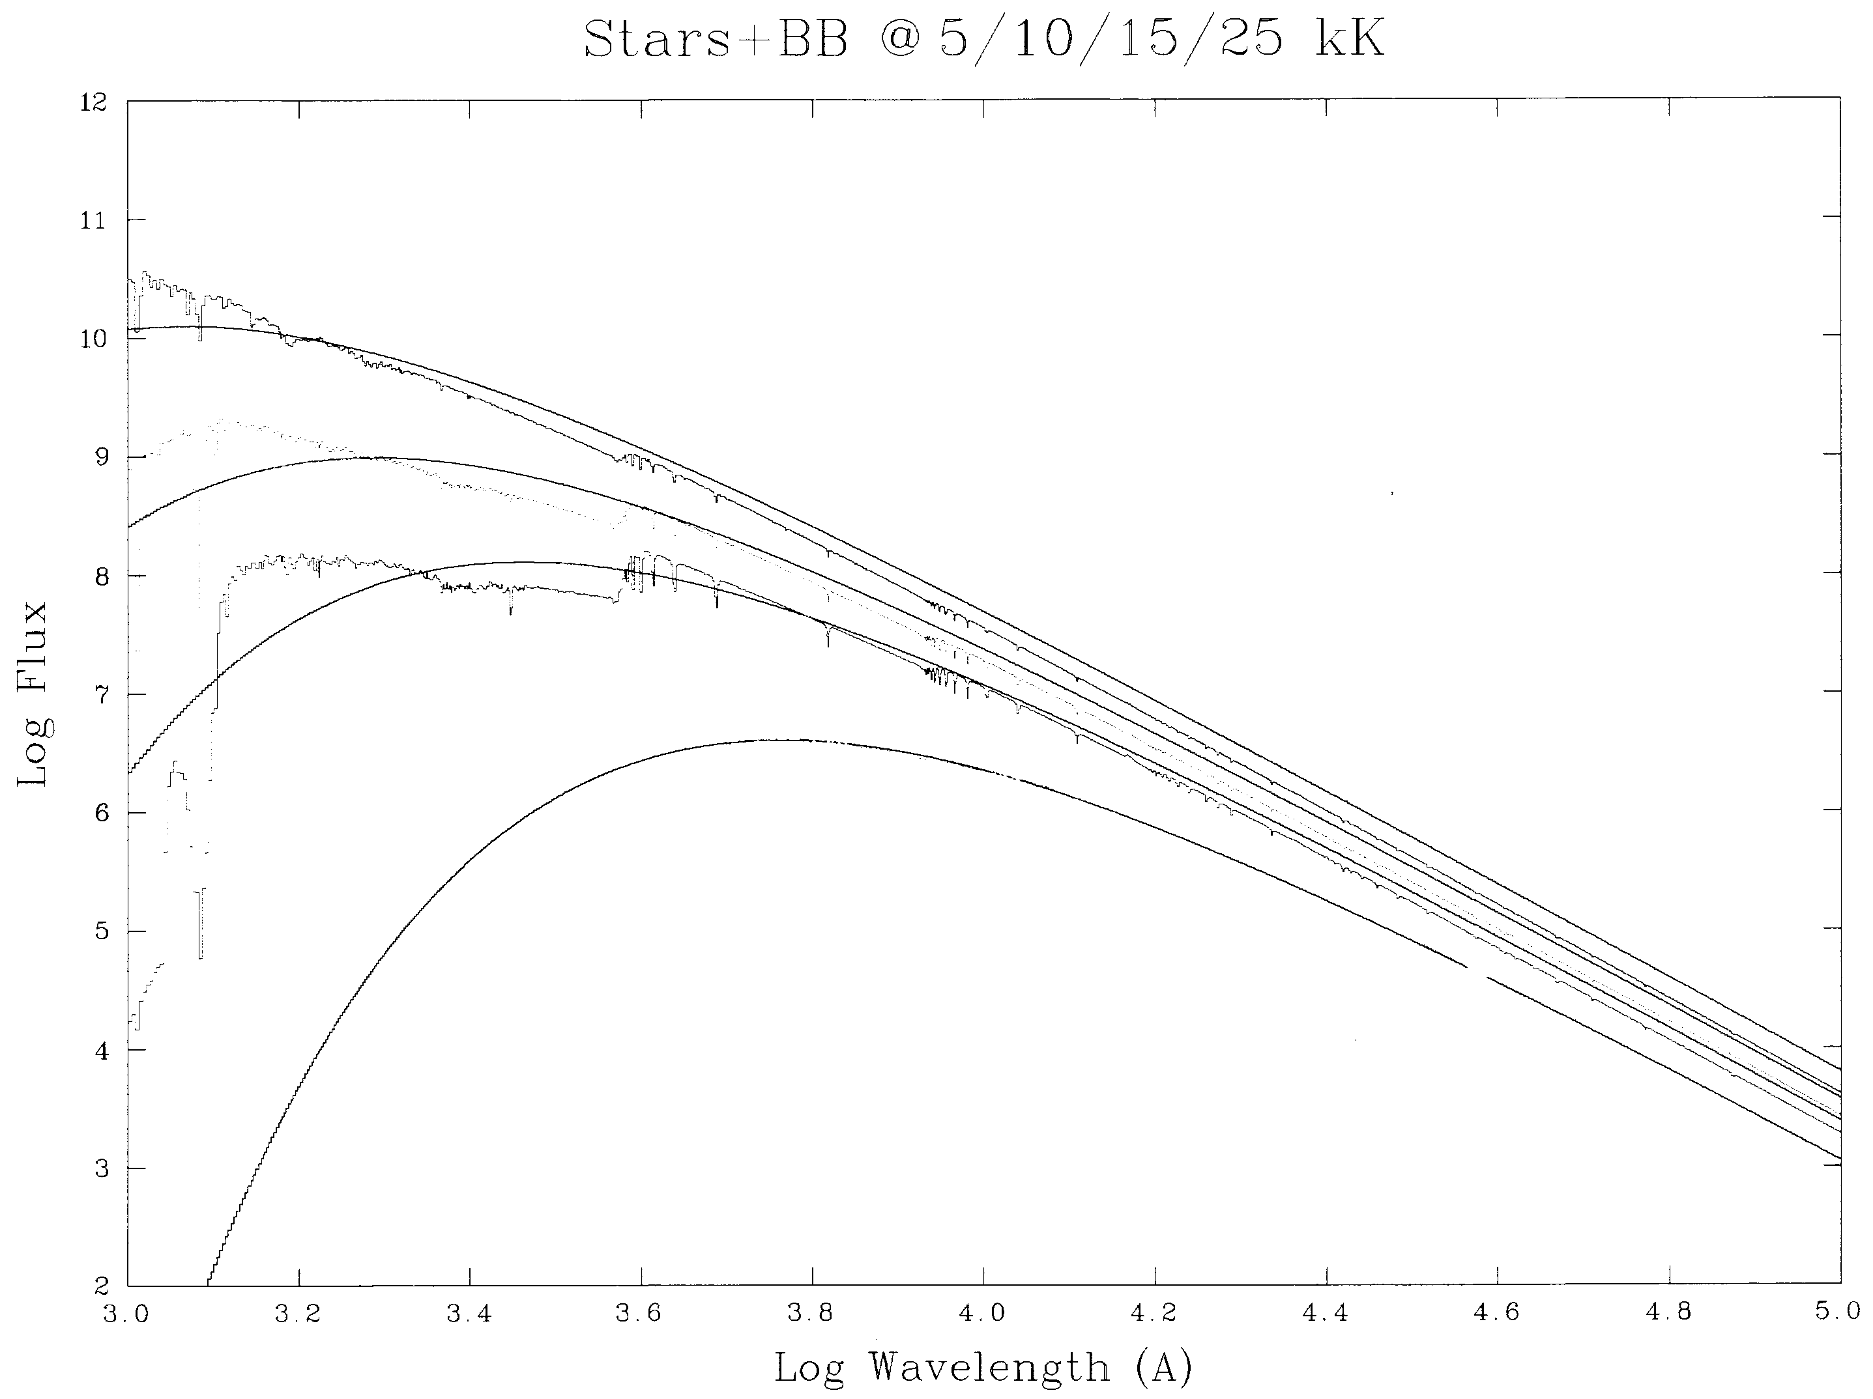
‘Thermal’ spectrum of radiation: e.g. STARS
Effective temperature T_{eff} of a star: Temperature of the blackbody
that would emit
the same total
energy as the
star
For the Sun:
T_{eff} 6000 K
Notes:
Which is the hottest star out of these four?

Slide 26
STARS
Intrinsic Properties
Observed Properties
Luminosity
Mass
Temperature
Size
Brightness
Distance
Objectives are to obtain the intrinsic properties of stars.

Slide 27
Astronomers want to know their intrinsic properties and compare them to one another to learn about them as a class of object
Want intrinsic energy output: luminosity
But we only measure is their observed flux or brightness
But distance can convert brightness into luminosity
We measure brightness and distance and to get luminosity

Slide 28
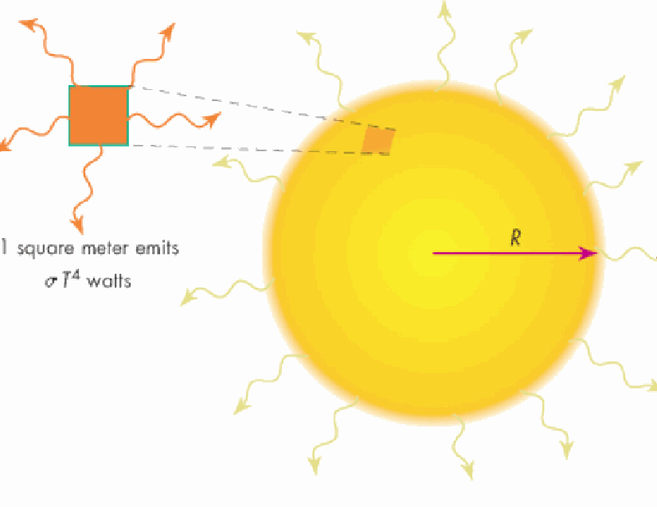
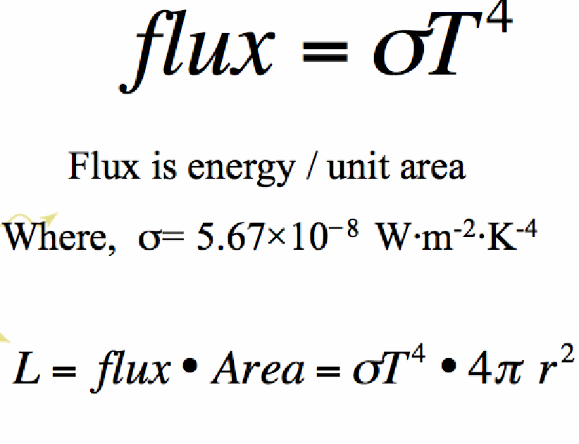
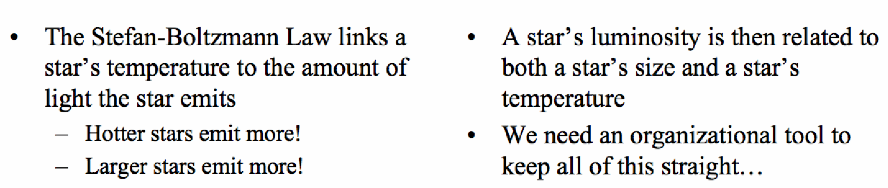

Slide 29
‘Thermal’ spectrum of radiation: Blackbody (7)
Stefan-Boltzmann law
Area under Planck’s curve
(by integrating Planck’s function over wavelength and all solid angles) is the total power emitted per unit area:
W m⁻²
= 5.67 x 10⁻⁸ W m⁻² K⁻⁴
= Stefan-Boltzmann’s constant
Luminosity of star of radius R (emitting as a blackbody)
W
W m⁻² λ⁻¹ sr ⁻¹
Notes:
Note log-log plot. Again curves are very peaked, with peak moving to higher frequency as temperature increases.
Stress difference L = 4πR²σT⁴, where R is the radius of the star, and F = L/(4πr²) where r is the distance.

Slide 30
The Size (Radius) of a Star
We already know: flux increases with surface temperature (~ T⁴); hotter stars are brighter.
But luminosity also increases with size:
A
Star B will be brighter than star A.
B
Luminosity is proportional to radius squared, L ~ R².
Quantitatively: L = 4 π R² σ T⁴
Surface flux due to a blackbody spectrum
Surface area of the star

Slide 31
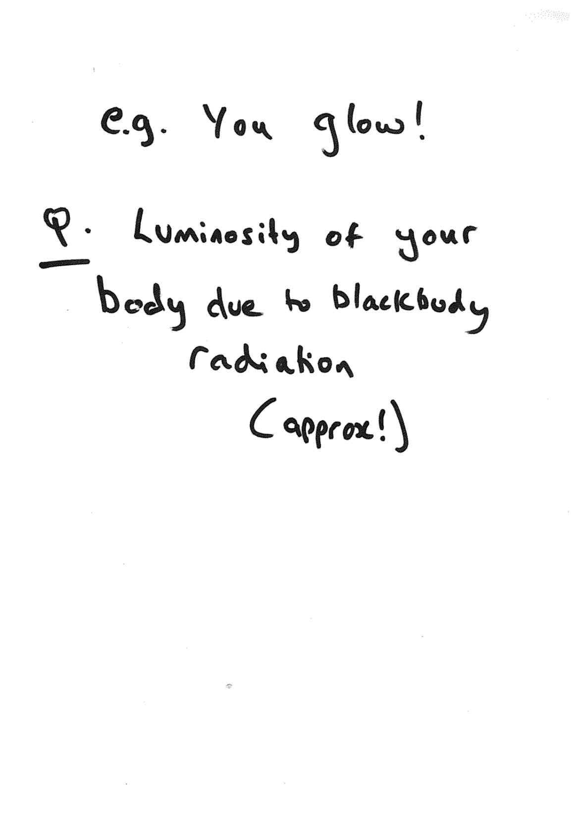

Slide 32
